Slide 1

Pocket FEM © Software Lab 2018
Students:
Cakal, Karakaya, Meßmer
Technische Universität München
Computational Mechancis
Department of Civil, Geo and Engineering
Supervisers:
M.Sc. Raul Rodriguez
M.Sc. Quirin Aumann
Munich, 15. November 2018

Slide 2
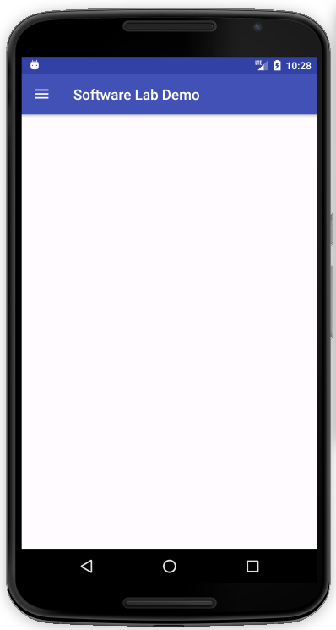


What’s Pocket FEM good for?
Two Major Fields of Application
Teaching Tool
Helps students to understand the workflow of FEM
Solutions can be obtained easily
Portable Computational Support
Analyse structure on site
Provides first rough estimation of the problem
www.Colourbox.de
www.Colourbox.de

Slide 3

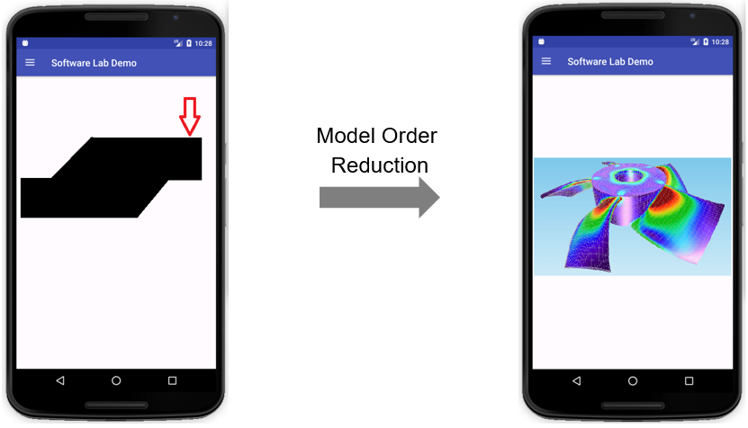
Where did we start?
We started from the very beginning…
Our Task is…
Create a 2D - FEM framework that runs on a wide range of Android devices
Guide user intuitively from Geometry Creation to Post-Processing
Provide a Model Order Reduction Method to solve models more efficiently and be able to solve more complex (bigger) systems
BE FAST

Slide 4
Design Pattern: Model View Controller
GUI (user)
VIEW
Provides user interface
Renderer tool
Update UI
CONTROLLER
Receives user actions, and updates model and view
Android activities
User Actions
Manipulate Model
Independent from each other
Parallel development
No global effect due to local changes
Easy management of complex application
Notify Change
MODEL
Contains computational parts
FEM package

Slide 5

How do we use C++ and Java together?
Outcomes;
Enhanced control on memory management
Faster FEM Calculations
Cross-platform development
Easy future implementations of FEM Package
Android App
SDK
Java
JNI
Native Libs
NDK
C++

Slide 6
FEM Package
Mathkernel
3
Solves the reduced equation system
Technically the same job but decreased complexity.
2
Post Processing
4
Femkernel
1
MOR Package
Geokernel
Reduce Matrices
Decrease complexity
Utilities

Slide 7
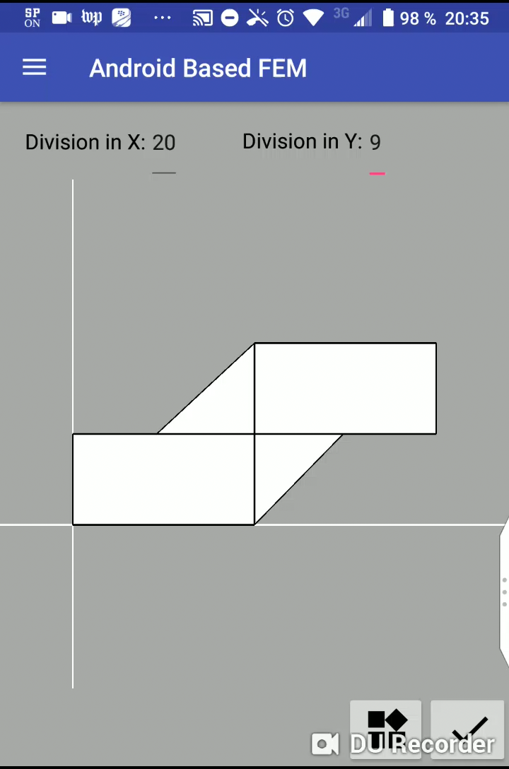
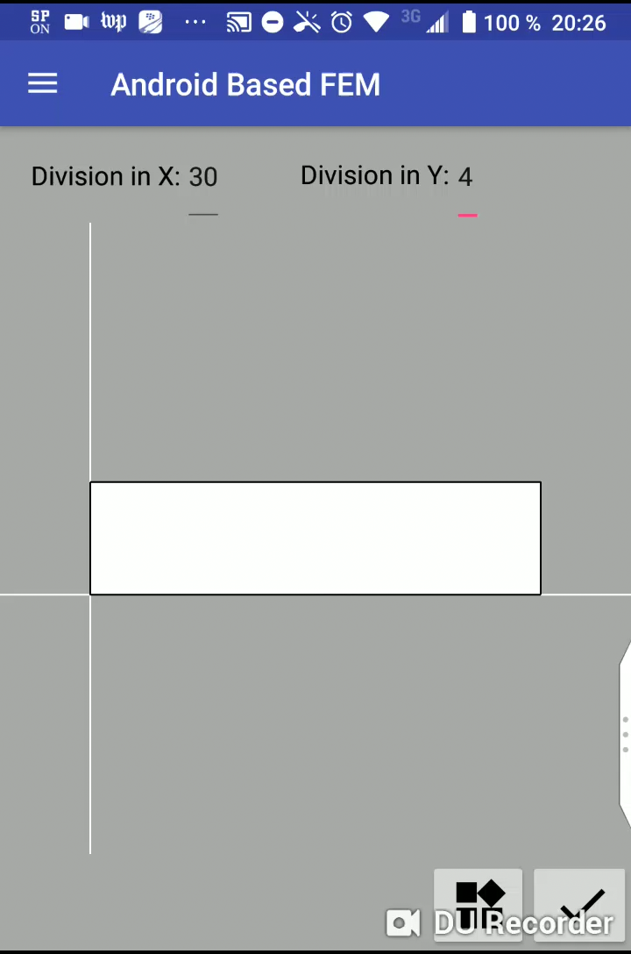
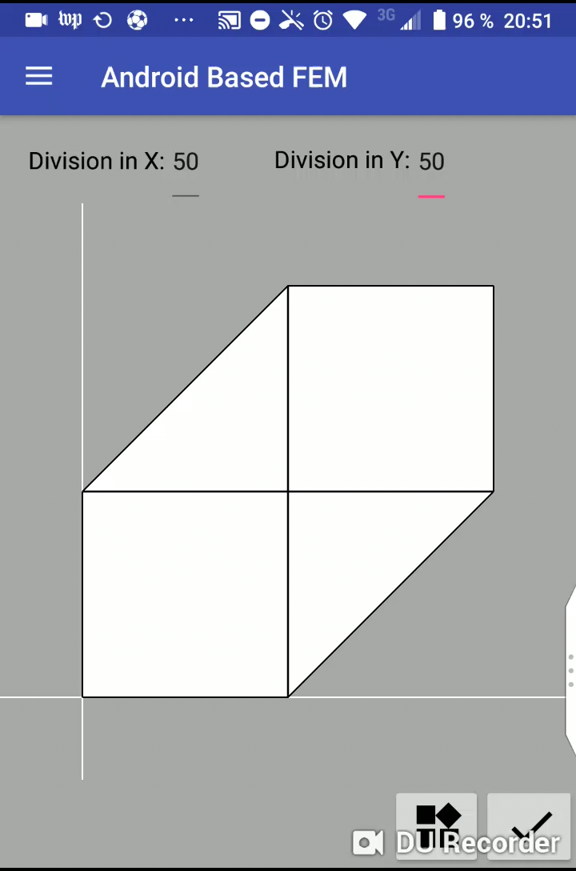
What is Pocket FEM capable to do?
Create Geometry
Mesher
Apply BC‘s
Static Solver
Dynamic Solver
Postprocessing
Pocket FEM ©

Slide 8
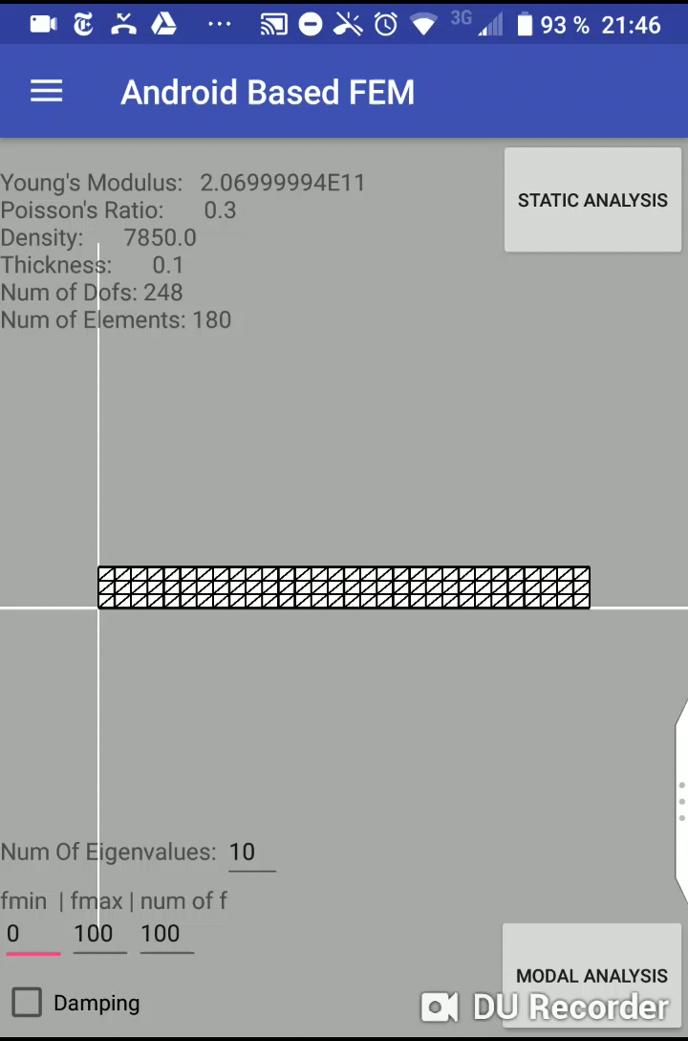
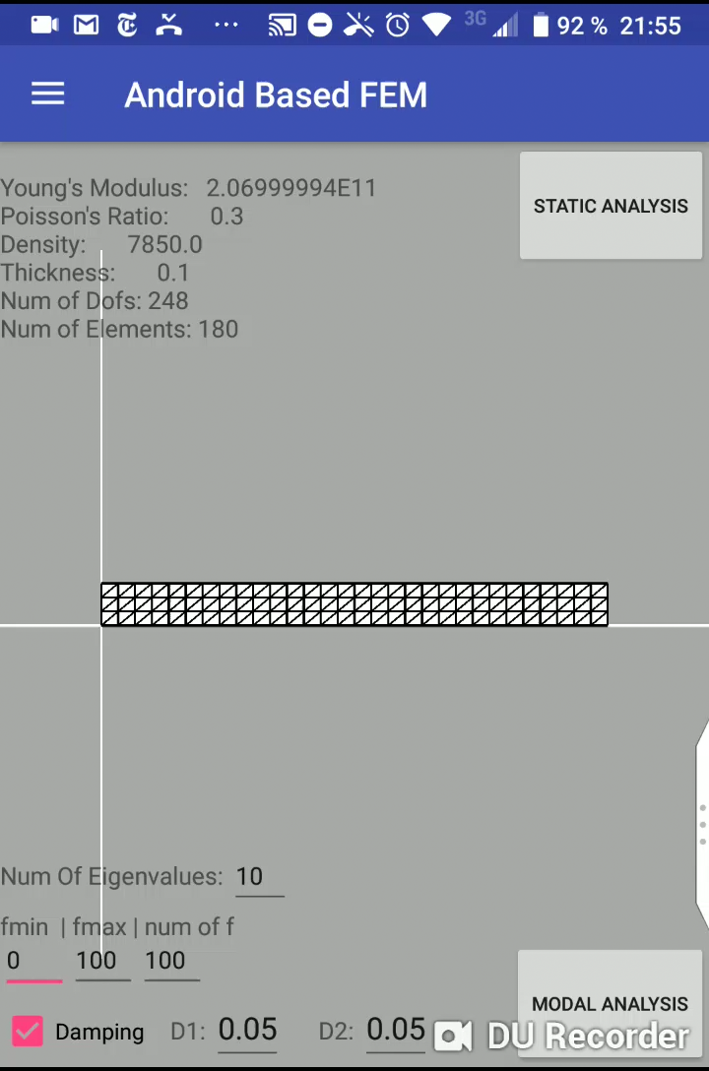
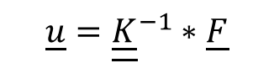
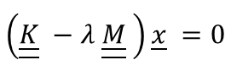
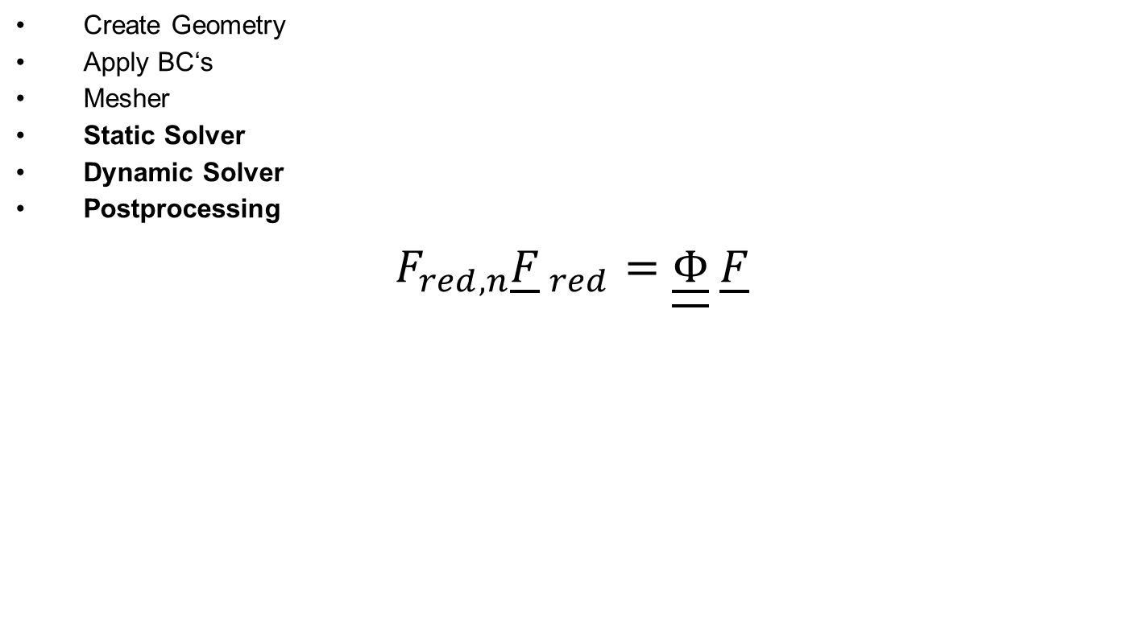
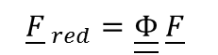
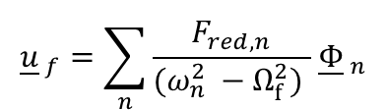
What is Pocket FEM capable to do?
Create Geometry
Apply BC‘s
Mesher
Static Solver
Dynamic Solver
Postprocessing
$$F_{red,n}{\underline{F}}_{ red}=\underline{\underline{Φ}} \underline{F}$$
Static Solver
$${\underline{u}=\underline{\underline{K}}}^{−1}∗\underline{F}$$
111 Displacement Field:
2sec
11100 Displacement Fields:
5sec
Eigenfrequencies:
1.45 Hz
8.9 Hz
21.45 Hz
Dynamic Solver
$$\left(\underline{\underline{K}} −λ \underline{\underline{M}} \right)\underline{x} =0$$
$${\underline{F}}_{ red}=\underline{\underline{Φ}} \underline{F}$$
$${\underline{u}}_{ f}=\sum_{n}{\frac{F_{red,n}}{(ω_{n}^{2} −Ω_{f}^{2}) }}{ \underline{Φ}}_{ n}$$
Pocket FEM ©

Slide 9
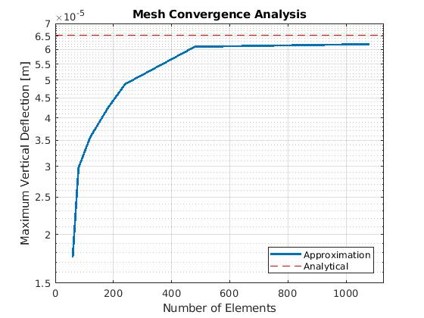
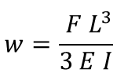
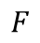
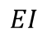
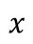
Validation of the results
$$F$$
$$EI$$
$$x$$
Bernoulli Theory
$$w=\frac{ F L^{3}}{3 E I}$$

Slide 10
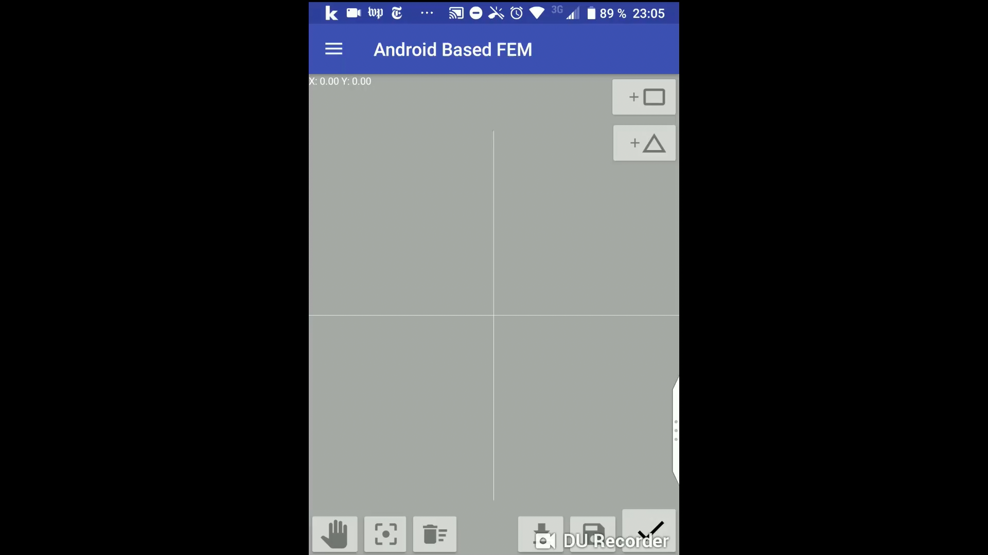
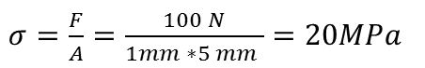
Validation of the results
t = 1
F = 100N
$σ=\frac{F}{A}=\frac{100 N}{1mm ∗5 mm }=20MPa$
5
Pocket FEM ©

Slide 11
Proposal for future projects
FEM Kernel
Improve meshing algorithm
Enhance element formulation (higher order shape functions)
Add different element types ( e.g. quadrilaterals)
Java App
Modify „create geometry“ fragment, once more advanced meshing alorithms are available

Slide 12




Ranking of Pocket FEM
Pocket FEM
LS Dyna
Abaqus
Ansys
Kratos
Kratos
Pocket FEM
Abaqus
Ansys
Ansys
Pocket FEM
Abaqus
Kratos
LS Dyna
Pocket FEM
LS Dyna
Kratos
Abaqus
Ansys

Slide 13
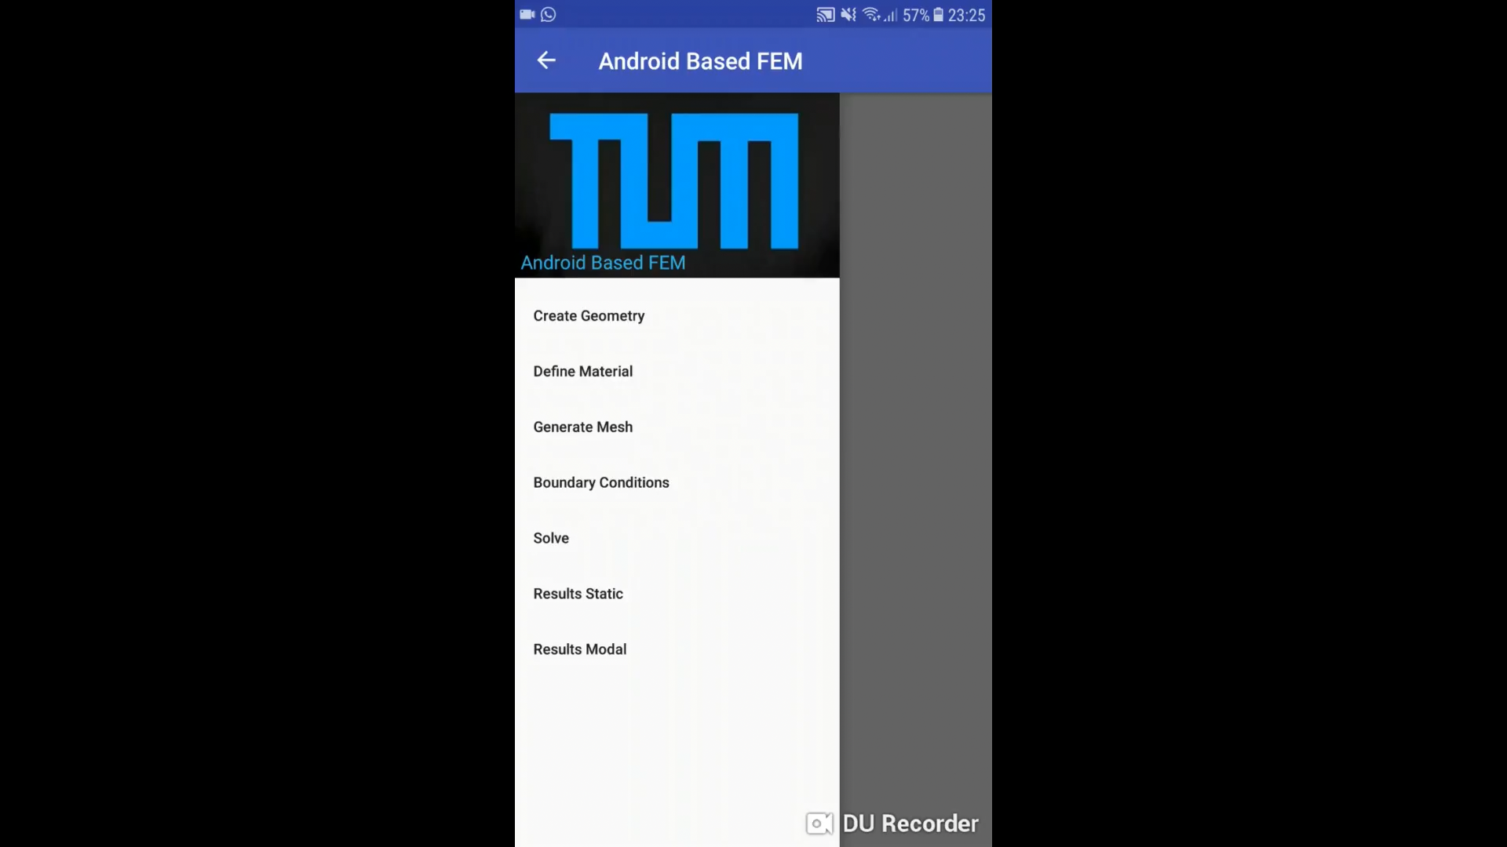
What else is Pocket FEM capable to do?

